Slide 1
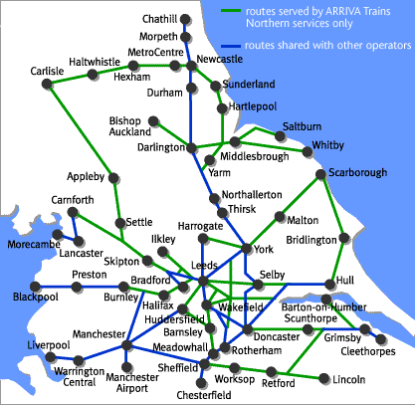
Algorithms on graphs
In Decision Mathematics, a graph consists of points (called vertices or nodes) which are connected by lines (edges or arcs).
Eg in the map below, the towns are nodes and the routes between them are arcs
This section considers algorithms that find the shortest route that:
connects all nodes in a graph
gets you from ‘A to B’
travels along every arc in a network
Modern journey planner tools use these algorithms to find routes that minimise time, distance or cost as required.

Slide 2
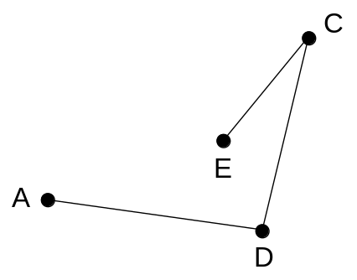
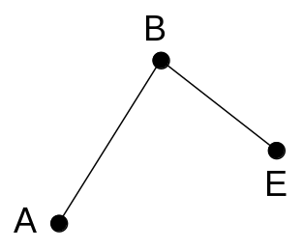
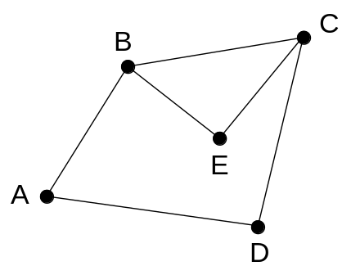
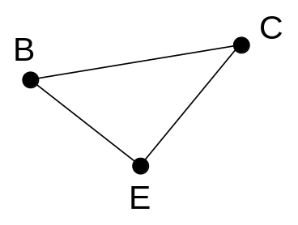
Graph terminology
A path exists between 2 nodes if you can get from one to the other without passing through any other node twice
C
B
Eg there is a route from A to E via the paths ABE or ADCE
E
A
D
A walk is a path in which you are permitted to pass through nodes more than once
A cycle is a ‘closed’ path – one that starts & finishes at the same node
Eg there is a walk starting & finishing at A via BECB
Eg the cycle BCE

Slide 3
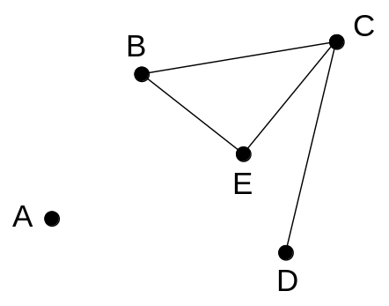
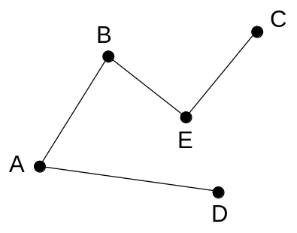
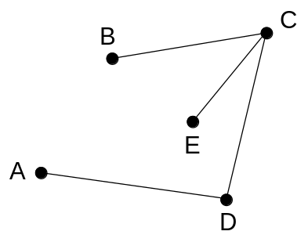
Graph terminology
A tree is a connected graph with no cycles
C
B
E
A
D
A graph is connected if there is a path between any two nodes
A spanning tree is a tree which includes all nodes in a network
Eg the graph above is connected
Eg there are many spanning trees of the graph shown:
But remove arcs AB and AD and it isn’t

Slide 4
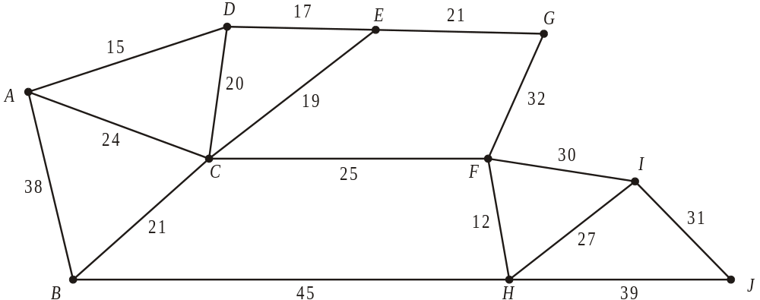
Prim’s algorithm
Prim and Kruskal’s algorithms find a Minimum Spanning Tree (MST)
Eg The network in the diagram below shows the distances, in metres, between 10 wildlife observation points. The observation points are to be linked by footpaths, to form a network along the arcs indicated, using the least possible total length.
Find a minimum spanning tree for the network, showing clearly the order in which you selected the arcs for your tree, using Prim’s algorithm, starting from A.
With Prim’s algorithm, consider arcs from the shortest to the longest, adding them to the MST if they do not form a cycle

Slide 5
Order arcs included:
AD
DE
EC
EG
CF
FH
HI
IJ
CB
Length of MST = 188
D
E
G
A
Add the shortest arc connected to the tree so far, provided it doesn’t form a cycle
I
C
F
B
J
H

Slide 6



















Distance matrices
Complete the table of distances for this network
A
B
C
D
E
F
A
-
20
18
16
-
-
B
20
-
15
-
-
50
C
18
15
-
10
20
30
D
16
-
10
-
23
-
E
-
-
20
23
-
25
F
-
50
30
-
25
-
Draw a network corresponding to this distance matrix
A
B
C
D
E
A
-
21
-
20
23
B
21
-
17
23
-
C
-
17
-
18
41
D
20
23
18
-
22
E
23
-
41
22
-

Slide 7
Prim from a table of distances
 | A | B | C | D | E | F | G
A | - | 165 | 195 | 280 | 130 | 200 | 150
B | 165 | - | 90 | 155 | 150 | 235 | 230
C | 195 | 90 | - | 170 | 110 | 175 | 190
D | 280 | 155 | 170 | - | 150 | 105 | 163
E | 130 | 150 | 110 | 150 | - | 90 | 82
F | 200 | 235 | 175 | 105 | 90 | - | 63
G | 150 | 230 | 190 | 163 | 82 | 63 | -
Eg An area manager has to visit branches of his company in 7 towns A, B, C, D, E, F and G. The table shows the distances, in km, between these 7 towns. The manager lives in town A and plans a route starting and finishing at this town. She wishes to visit each town and drive the minimum distance.
Starting from A, use Prim’s algorithm to find a minimum connector and draw the minimum spanning tree. State the order in which you selected the arcs.
MST:
A
E
G
F
D
Arcs selected:
AE,
EG,
GF,
FD,
EC,
CB
C
Weight = 130 + 82 + 63 + 105 + 110 + 90 = 580
B

Slide 8
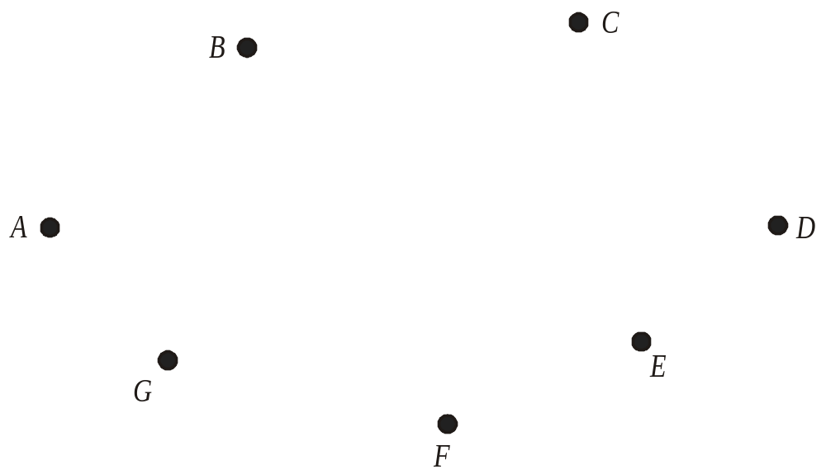
WB5 The table shows the lengths, in metres, of the paths between seven vertices A, B, C, D, E, F and G in a network N.
 | A | B | C | D | E | F | G
A | — | 48 | 117 | 92 | — | — | —
B | 48 | — | — | — | — | 63 | 55
C | 117 | — | — | 28 | — | — | 85
D | 92 | — | 28 | — | 58 | 132 | —
E | — | — | — | 58 | — | 124 | —
F | — | 63 | — | 132 | 124 | — | —
G | — | 55 | 85 | — | — | — | —
(a) Use Prim's algorithm, starting at A, to solve the minimum connector problem for this table of distances. You must clearly state the order in which you selected the edges of your tree, and the weight of your final tree.
Draw your tree using the vertices given in the diagram below.
Arcs selected:
AB
, BG
, BF
, GC
, CD
, DE
Weight = 337m

Slide 9
WB6(a) Define the terms
(i) tree …………………………………………………………………………
(ii) spanning tree ………………………………………………………………
(iii) minimum spanning tree ……………………………………………………
A connected graph with no cycles, loops or multiple edges
A tree that includes all vertices
A spanning tree of minimum total length
(b) State one difference between Kruskal’s algorithm and Prim’s algorithm, to find a minimum spanning tree.
In Kruskal the shortest arc is added (unless it completes a cycle), in Prim the nearest unattached vertex is added
There is no need to check for cycles when using Prim but there is when using Kruskal
In Prim the tree always “grows” in a connected fashion
Kruskal starts with the shortest edge, Prim with any vertex
WB7(a) Explain what is meant by the term ‘path’.
A path is a (finite) sequence of edges, such that the end vertex
of one edge is the start vertex of the next and in which no vertex
appears more than once/no cycles.

Slide 10
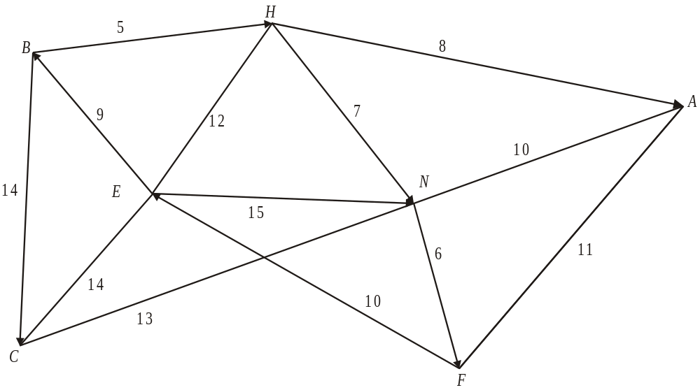
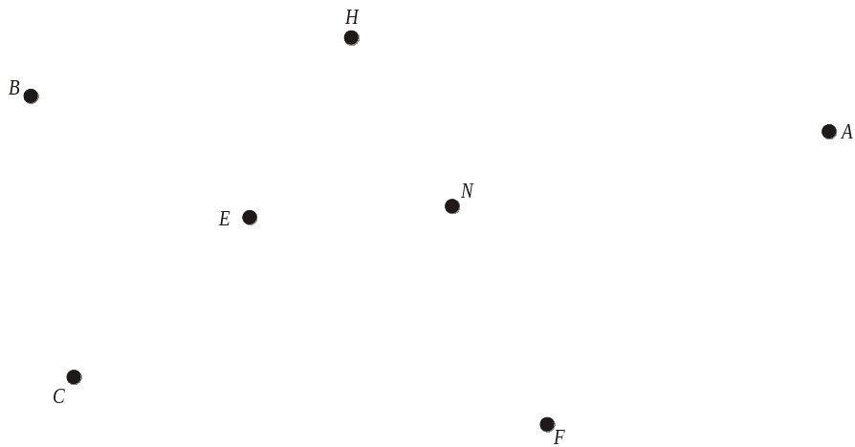
Kruskal’s Algorithm
WB6(c) Use Kruskal’s algorithm to find the minimum spanning tree for the network shown in Figure 1. State the order in which you included the arcs. Draw the minimum spanning tree in Diagram 1 below and state its length.
Figure 1
Order arcs included:
BH
NF
HN
HA
BE
NA
EF
AF
EH
CN
Length of MST = 48
List arcs in ascending order of size, only including them if they don’t form a cycle

Slide 11
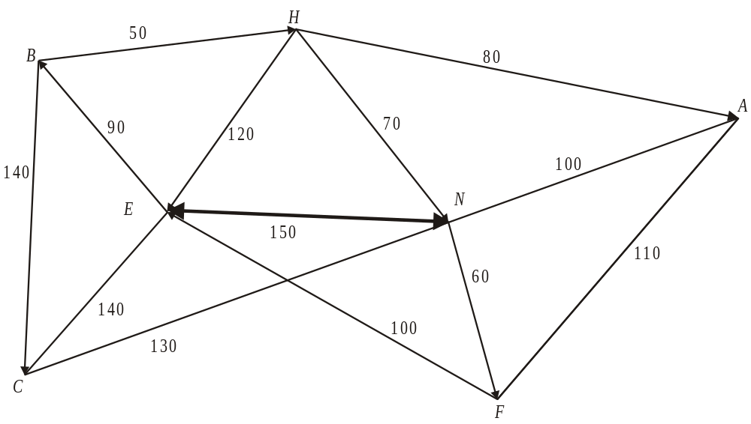
Figure 2 models a car park. Currently there are two pay-stations, one at E and one at N. These two are linked by a cable as shown. New pay-stations are to be installed at B, H, A, F and C. The number on each arc represents the distance between the pay-stations in metres. All of the pay-stations need to be connected by cables, either directly or indirectly. The current cable between E and N must be included in the final network. The minimum amount of new cable is to be used.
(d) Using your answer to part (c), or otherwise, determine the minimum amount of new cable needed. Use Diagram 2 to show where these cables should be installed. State the minimum amount of new cable needed.
Remove either BE, BH or HN so there are no cycles
Length of MST = 480
Answer to (c)
Remove longest BE
- 90
New cable needed = 390

Slide 12















Use Prim (starting from A) and then Kruskal’s algorithms to find MSTs for this network
Prim from A
Kruskal
IG
EK
AE
EF
EJ
FI
IG
GC
CD
CB
EK
KH
EF
CD
EJ
FJ
GC
GD
CB
FI
KH
FC
KJ
AE
Length of MST = 172
Length of MST = 172

Slide 13
Use Prim (starting from A) and then Kruskal’s algorithms to find MSTs for this network
Prim from A
Kruskal

Slide 14




















Use Prim (starting from L) and then Kruskal’s algorithms to find MSTs for this network
Prim from L
Kruskal
LT
TM
MQ
QN
ST
NP
MQ
LT
TM
QN
MN
ST
NP
QR
QR

Slide 15
Use Prim (starting from L) and then Kruskal’s algorithms to find MSTs for this network

Slide 16
The table shows the lengths, in mm, between six nodes A to F in a network.
 | A | B | C | D | E | F
A | — | 124 | 52 | 87 | 58 | 97
B | 124 | — | 114 | 111 | 115 | 84
C | 52 | 114 | — | 67 | 103 | 98
D | 87 | 111 | 67 | — | 41 | 117
E | 58 | 115 | 103 | 41 | — | 121
F | 97 | 84 | 98 | 117 | 121 | —
(a) Use Prim's algorithm, starting at A, to solve the minimum connector problem for this table of distances. You must clearly state the order in which you selected the edges of your tree, and the weight of your final tree.
Arcs selected:
AC
, CD
, DE
, AF
, FB
Weight = 341m
MST:
B
F
A
C
D
E
D

Slide 17
The table shows the lengths, in mm, between six nodes A to F in a network.
 | A | B | C | D | E | F
A | — | 124 | 52 | 87 | 58 | 97
B | 124 | — | 114 | 111 | 115 | 84
C | 52 | 114 | — | 67 | 103 | 98
D | 87 | 111 | 67 | — | 41 | 117
E | 58 | 115 | 103 | 41 | — | 121
F | 97 | 84 | 98 | 117 | 121 | —
(a) Use Prim's algorithm, starting at A, to solve the minimum connector problem for this table of distances. You must clearly state the order in which you selected the edges of your tree, and the weight of your final tree.

Slide 18
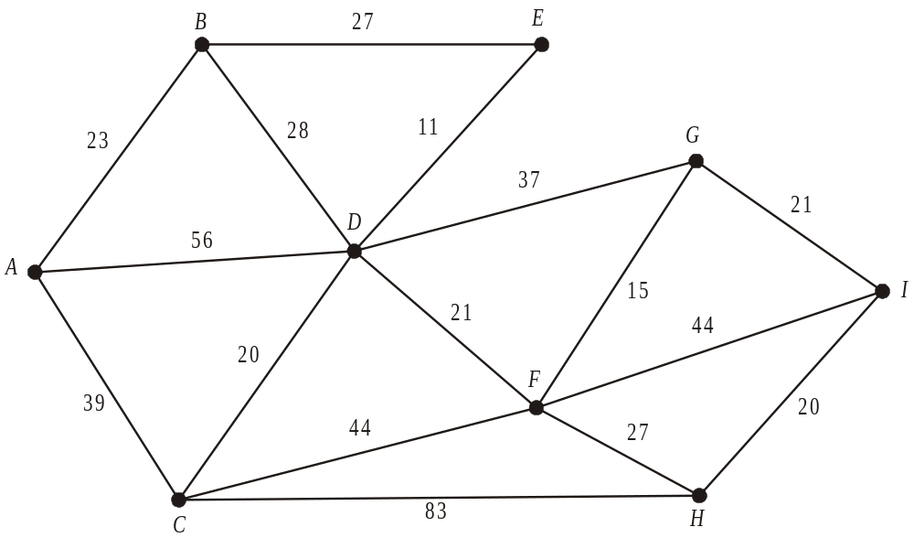
Dijkstra’s Algorithm
WB7 The figure below shows a network of cycle tracks. The number on each edge represents the length, in miles, of that track. Mary wishes to cycle from A to I as part of a cycling holiday. She wishes to minimise the distance she travels.
Use Dijkstra’s algorithm to find the shortest path from A to I.
Show all necessary working in the boxes in the diagram
State your shortest path and its length
(2)
Dijkstra’s algorithm finds the shortest route through a network

Slide 19
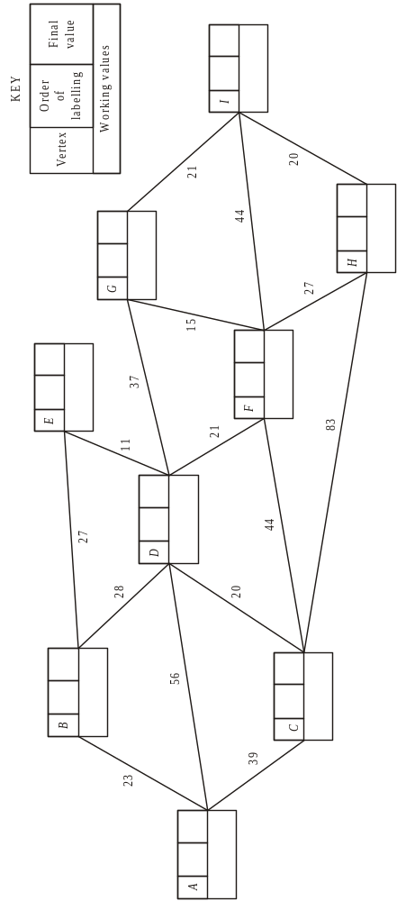
Dijkstra’s Algorithm
2
23
4
50
50
23
7
87
88
5
51
, 87
, 51
56
, 59
1
0
61
9
108
6
72
116
,108
,119
83
3
39
, 72
39
8
99
122
, 99
To find the route, trace back from end and include arc XY if Y already on the path and if the difference in final labels equals the length of arc
I
-21
G
-15
F
-21
D
-28
B
-23
A
Shortest path ABDFGI
Length 108

Slide 20
Mary wants to visit a theme park at E.
(d) Find a path of minimal length that goes from A to I via E and state its length.
2
23
4
50
50
23
7
87
97
88
5
51
, 87
61
, 51
1
0
56
9
108
118
6
72
82
116
,108
,119
83
3
39
, 72
39
8
99
122
, 99
Going via E,
Mary will reach D 10 later than previously
Giving route ABEDFGI, length 118

Slide 21
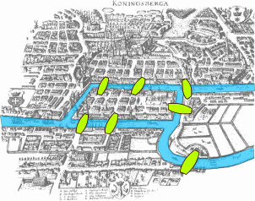
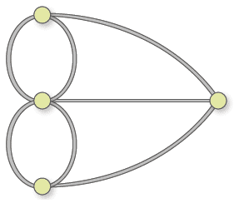
The 7 bridges of Konigsberg
Can you find a walk through the city that would cross each bridge once and only once?
The islands can’t be reached by any route other than the bridges, and every bridge must be crossed completely every time.
Euler reduced this to a graph, thinking of the districts of the city as nodes and the bridges as paths.
Arc
Node
Each node has an odd number of arcs connected
He realised that unless each node had an even number of arcs connected to it, a route could not be found.
Hence this particular problem is unsolvable.

Slide 22
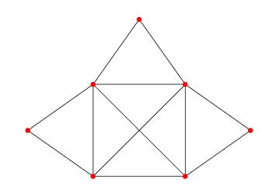
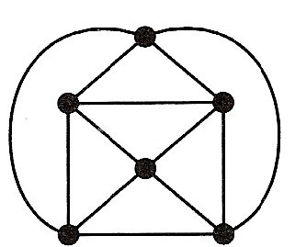
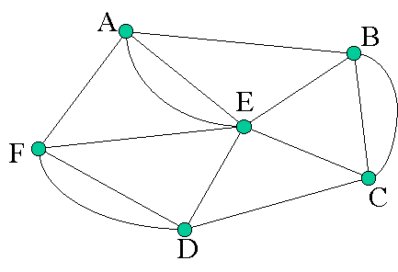
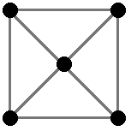
Can you find a walk around these networks?

Slide 23
Route inspection
3
3
117
WB5(c) Solve the Route Inspection problem for N.
You must make your method and working clear. State a shortest route and find its length.
48
85
28
4
92
3
55
132
58
63
124
2
2
3
Odd nodes:
A
B
C
F
Total weight = 802
Shortest routes:
AB + CF
= 48 + 160
= 208
AC + BF
= 117 + 63
= 180
So repeat AC and BF
AF + BC
= 111 + 140
= 251
Length of route = 802 + 180 = 982
Possible route, eg from A: ABFEDCGBFDACA

Slide 24
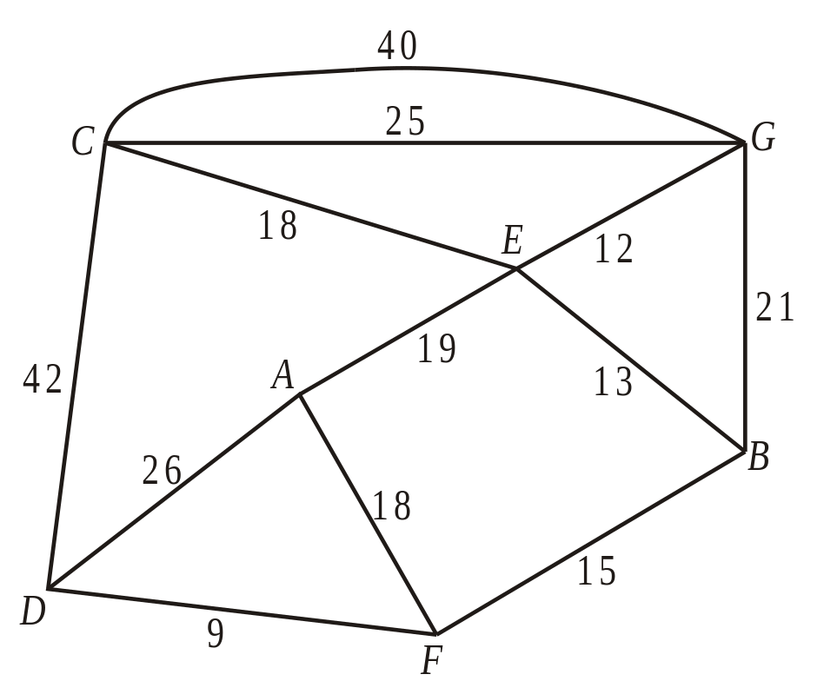
WB8 (a) Describe a practical problem that could be modelled using the network in the diagram above and solved using the route inspection algorithm.
(b) Use the route inspection algorithm to find which paths need to be traversed twice.
(c) State whether your answer to part (b) is unique. Give a reason for your answer.
(d) Find the length of the shortest inspection route that traverses each arc at least once and starts and finishes at the same vertex.
Odd nodes:
A
B
D
F
Shortest routes:
via E
AB + DF
= 32 + 9
= 41
AD + BF
= 26 + 15
= 41
AF + BD
= 18 + 24
= 42
So repeat either AE, EB and DF
or AD and BF
Total weight = 258
Length of route = 258 + 41 = 299
You may have to consider the shortest of a number of routes

Slide 25
Given that it is permitted to start and finish the inspection at two distinct vertices,
(e) find which two vertices should be chosen to minimise the length of the route.
Give a reason for your answer.
AB + DF
= 32 + 9
= 41
AD + BF
= 26 + 15
= 41
AF + BD
= 18 + 24
= 42
DF is the shortest, so repeat that and start/finish at A/B
If you can start/finish at different nodes, then you only need to repeat one arc…

